Slide 1


OBJECT ORIENTED PROGRAMMING THROUGH JAVA

Slide 2

L7 - SCOPE AND LIFETIME OF THE
VARIABLES

Slide 3


Slide 4
SCOPE AND LIFETIME OF THEVARIABLE:-
Scope and Lifetime of variables define the section of the code in which the variable is visible. As a general rule, variables that are defined within a block are not accessible outside that block.
The lifetime of a variable refers to how long the variable exists before it is destroyed. Destroying variables refers to deallocating the memory that was allotted to the variables when declaring it..
The ones declared in the body of a method were different from those that were declared in the class itself.
There are three types of variables:
Instance variables
Argument variables
Local variables

Slide 5
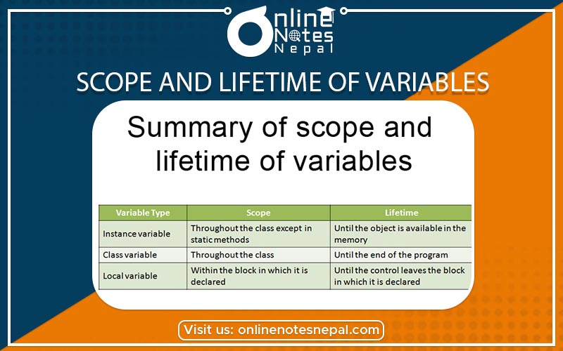
Scope

Slide 6
In programming, a variable can be declared and defined inside a class, method, or block.
It defines the scope of the variable i.e. the visibility or accessibility of a variable.
Variable declared inside a block or method are not visible to outside.
If we try to do so, we will get a compilation error. Note that the scope of a variable can be nested.
We can declare variables anywhere in the program but it has limited scope.
A variable can be a parameter of a method or constructor.
A variable can be defined and declared inside the body of a method and constructor.
It can also be defined inside blocks and loops.
Variable declared inside main() function cannot be accessed outside the main() function

Slide 7
Next….
SCOPE AND LIFE TIME OF VARIABLE
Notes:
In Slide Show mode, click the arrow to enter the PowerPoint Getting Started Center.

Slide 8



